Slide 1
What to use in Python scripting

Slide 2
IDEs versus Notebooks
Choosing between an IDE and a notebook ultimately depends on the nature of your work and personal preference

Slide 3
IDEs
comprehensive, efficient, and robust environment for full-scale software development
Developing large-scale applications or complex projects.
When you need robust debugging, refactoring, and version control tools.
Managing extensive codebases with multiple files and dependencies.
Performance-critical applications requiring efficient resource management.
Examples
Visual Studio (VS)Code
PyCharm
DataSpell

Slide 4
Notebooks
interactive, user-friendly, and collaborative platform ideal for data science and research tasks
Data analysis, exploration, and visualization tasks.
Prototyping and experimenting with code snippets.
Creating tutorials, reports, or research documentation.
Collaborative projects where sharing and reproducibility are key.
Examples
Jupyter notebook
Google Colab

Slide 5
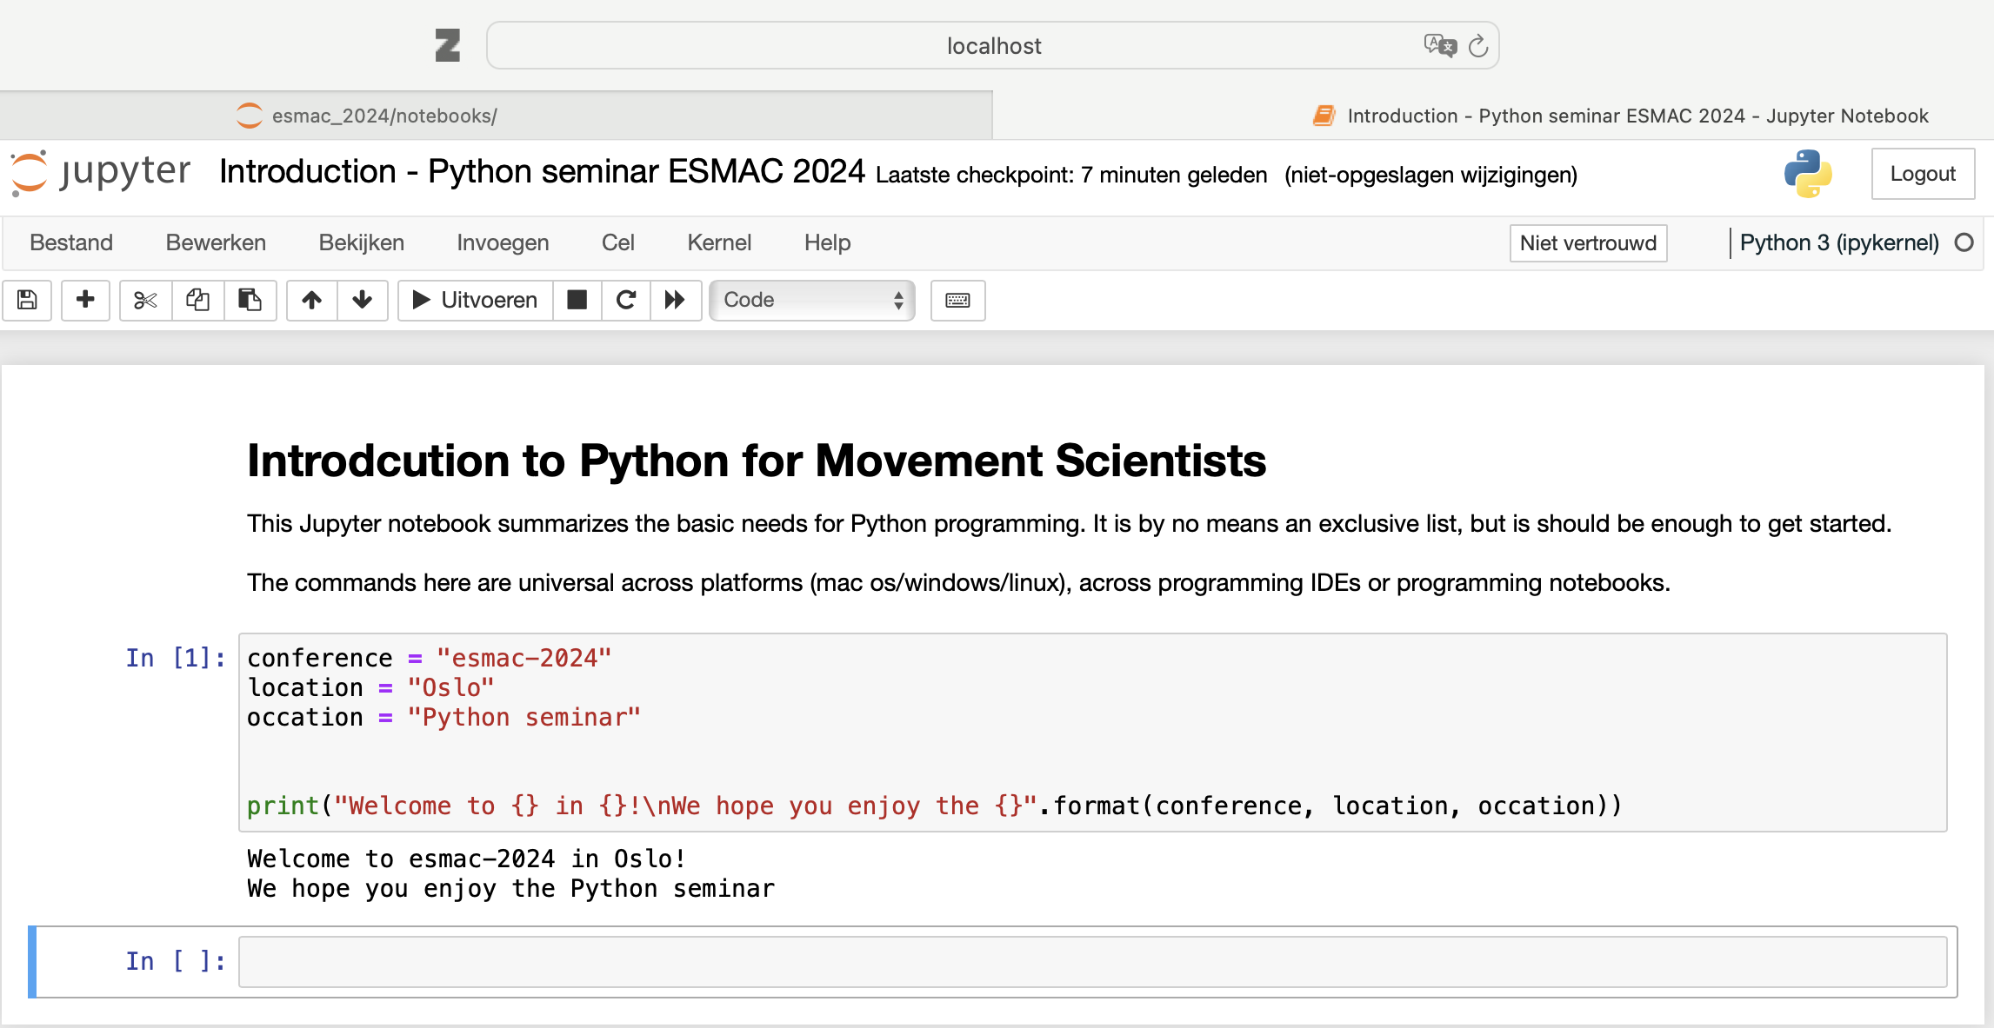
Navigating Jupyter Notebook
Local host in the background
Jupyter notebook
Add cell
Run cell
}
Markdown cell
Switch cell
}
Code cell
}
Output

Slide 6
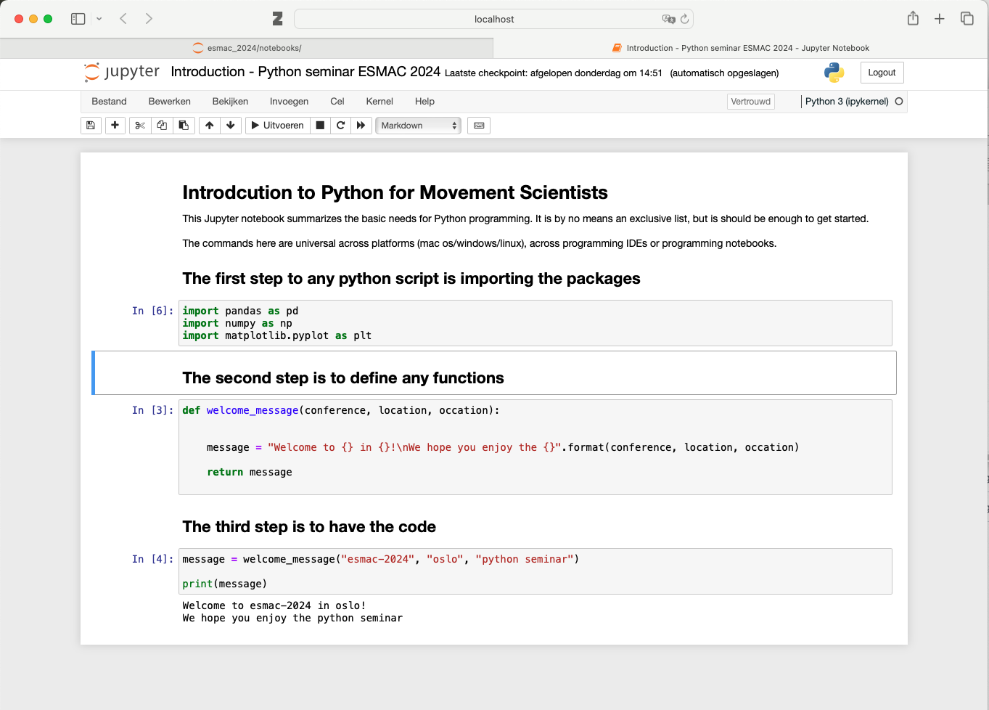
General flow of a python script
Text with goal of notebook
Import statements
}
Python functions
}
Code cell
}
Output
Python code

Slide 7
General flow of a python script
Shown in Jupyter Notebook, but it is the same for all programs

